Slide 1
Study Better
Mrs. Papa

Slide 2
Why Study?
Studying is essential for a person to develop a complete education and provides students with the opportunity to develop habits for a successful life.
Time management skills
Self-discipline
increase the student's ability to comprehend material.
Improve Self-esteem
Activate Self-Awareness

Slide 3
Studying & the Brain
Each time you learn something new and practice it your brain will
change the structure of its neurons (cells)
increase the number of synapses between your neurons allowing them to send and receive information faster
The more you know, the better your brain functions.

Slide 4
Why do we learn differently
We learn differently because of many reasons.
Environment
Genetics – IQ (how we process information naturally)
Cultural - Family values toward education
Natural learning preference (how I like to learn)
Personal history (reward vs consequences)
Physical ability

Slide 5
What kind of Learner am I - Quiz
LearningStyleInventory.pdf

Slide 6
My Learning Style

Slide 7
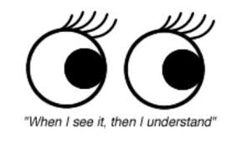
Visual (Spatial)
Visual learners are those that learn best when they have images to help them process the information. This learning style requires them to first see what they’re expected to know. They may also need to map out or write out their thoughts in order to really process what they are thinking.
Visual learners:
Have good spatial sense and sense of direction
Can easily visualize objects, plans, and outcomes
Like coloring, drawing, and doodling
Have good color balance
Are good at using maps and rarely get lost
A visual learner in a writing class may process the information better by seeing a movie clip of how a film adapts the literature it was based on, instead of listening to the literature being read aloud.
You are a visual learner if: You prefer pictures, images, and mind maps to help you process information.

Slide 8
Verbal (Linguistic)
Verbal learners learn best both under verbal instruction and writing. They typically excel with both. These learners are typically those that go into public speaking, writing, journalism, and debating.
Verbal learners:
Express themselves in both written and spoken word
Enjoy reading and writing
Like tongue twisters and rhymes
Has a large vocabulary and enjoys learning new words
For example, reading definitions of a word aloud or writing them down a few times, are ways for verbal learners to process information.
You are a verbal learner if: You need to read content aloud to learn something or prefer to have someone speak the information to you so you can process it.

Slide 9
Physical (Kinesthetic)
Physical learners are extremely animated and always need to be moving. They learn best by going through the motions of what they are learning.
Physical learners:
Notice and appreciate the physical world around them, such as textures
Enjoys sports and exercise along with outdoor activities and working with their hands
Tend to use and pick up on body language
Enjoy making models or doing jigsaw puzzles
For example, if something is bothering you or you are trying to wrap your head around a concept, you would rather go for a run or walk than sit down and figure it out.
You are a physical learner if: You don’t learn something until you do it, and need to draw out your own diagrams or role play to learn new information. You may also be constantly in motion and speak with your hands.

Slide 10
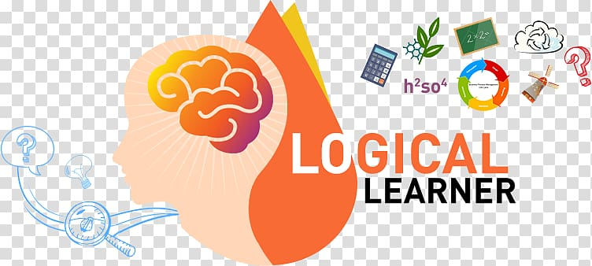
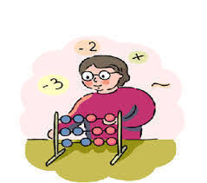
Logical (Mathematical)
Most logical thinkers end up being engineers, mathematicians, or pursuing the sciences. This is because they have a very unique way of learning. They are the individuals who want to understand the reason behind content or skills and tend to enjoy games like chess and doing brainteasers.
Logical learners:
Classify and group information together to better understand it
Perform complex calculations
Create procedures for future use, after coming up with a solution to a problem
Plan agendas and itineraries and even rank and number them
Those who prefer making a neat and organized list while studying and extracting key points from material for these lists are typically logical learners.
You are a logical learner if: You can learn something only when you understand the bigger picture, along with the logic, reasoning and systems behind that concept.

Slide 11
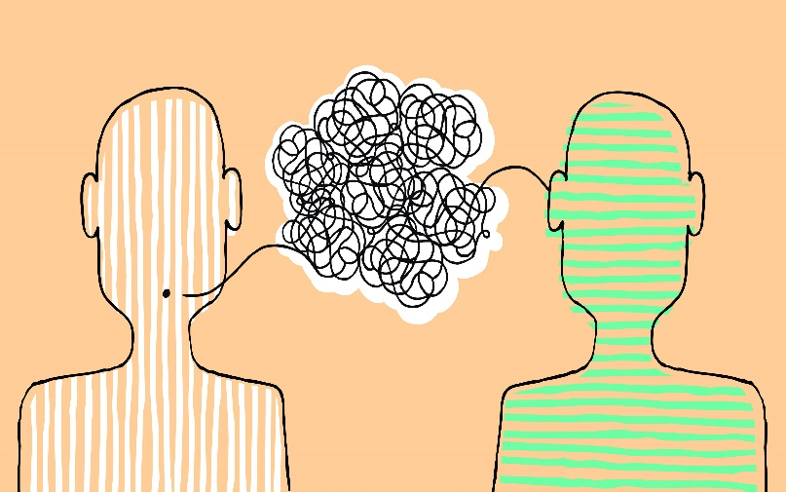
Social (Interpersonal)
As the name suggests, social learners are natural group workers. For students, these are the individuals that seem to be involved in every extracurricular activity. For adults, they are the individuals that like to be engaged with others, work on teams, and ask their peers for feedback in order to learn.
Social learners:
Prefer to socialize after work or class
Enjoy playing group sports
Bounce ideas off of others and to work through issues in a group
Listen well
Are often trusted by others for their advice
For example, in school when teachers assign group projects, it is often a way to appeal to social learners.
You are a social learner if: You prefer to work with other people and find you learn best in groups.

Slide 12
Solitary (Intrapersonal)
Solitary learners are individuals who simply prefer to learn on their own and keep to themselves. In most situations, this is a learning style for socially introverted people—but not always. There are some people who are extroverts in social situations but prefer to be alone when they are trying to learn. They also tend to be concerned with goals and outcomes.
Solitary learners:
Spend time on self-analysis
Prefer to relax or travel away from crowds
Think independently
Journal, write, and record personal thoughts and events as a way to improve.
Someone who reads self-help books to develop a deeper understanding of themselves is often a solitary learner.
You are a solitary learner if: You need to sit alone and study by yourself in order to retain information.

Slide 13
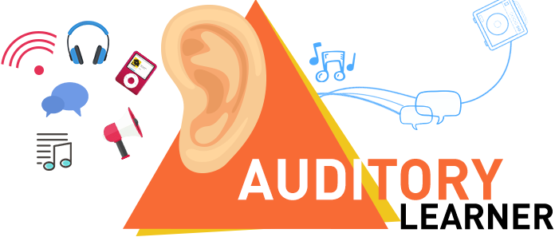
Auditory-Musical
Auditory learning is a unique type of learning style, but it is used to classify those who respond primarily to sound. Unsurprisingly, most musicians are aural learners. This is a learning style that isn’t often addressed in many schools because it can be hard to teach outside of music class. These are also individuals who respond best to things such as binaural beats.
Auditory learners:
Find that certain music invokes strong emotions
Enjoy listening to music in the background while learning
Have a good sense of pitch or rhythm
Often hear songs, jingles, and themes tend to pop in their head without prompts
A song that helps you remember the alphabetical order of all the states is a way to tap into aural learning styles.
You are an aural learner if: You prefer learning through rhythms or tend to use clever rhymes to remember something.

Slide 14
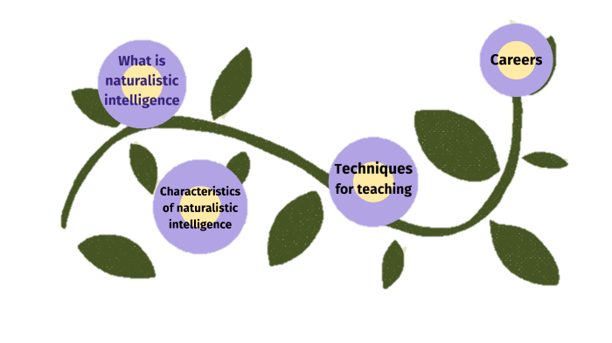
Naturalistic Learning
Naturalistic learning focuses on the need to be outside in nature to guide the learning process.
Naturalistic Learners :
Consider hosting various presentations or talks outside
Create guides for how to learn more about your topic out of doors
Explain how your audience can observe your topic in the real world
Work one-on-one with audience members outside
Connect with naturalistic learners by offering one-on-one sessions outside or allow students to work outside regularly.
You are a social learner if: If you prefer to be out of doors, observing how things work in nature. Unsurprisingly, those with this learning style often end up becoming scientists or horticulturists.

Slide 15
STUDY SKILLS
Time Management
Get Organized
Set Goals
Plan
Change Habits
Make a Decision

Slide 16
Time Management and Goal Setting
Make a schedule - Plot out your day realistically
Plan for your projects and tests arrange time in your day to study
Work on 1 thing at a time
Make study/homework time in short bursts with built in breaks
Make achievable goals for your self daily, weekly, monthly
Set aside time to take break. Hour of work half hour of break.
Sleep is a must
Don’t over extend yourself. Learn to balance your day
Ask for help when needed
Plan a study group

Slide 17
Get Organized and Plan
Write Things Down.
Make Schedules and Deadlines.
Don't Procrastinate.
Give Everything a Home
Declutter Regularly
Keep Only What You Need
Set reminders on your phone
Use your phone calendar

Slide 18
Change Habits and Make Decisions
Find your ideal working environment and then change it up!
Be an active reader with a pen in your hand
Take good notes in class and record lectures.
Plan your study time and start early. ...
Avoid distractions. ... Practice Focusing
Know when to ask for help.
Make your own study area
Practice active listening
Stay Positive – even when you fail – don't give up!

Slide 19
Resources
Study Skills: https://ingeniusprep.com/blog/high-school-study-skills/
Time Management: https://toggl.com/time-management-tips/
Time Management Tips: https://www.uopeople.edu/blog/10-best-time-management-tips-for-students/
Study Skills Tips: https://www.educationcorner.com/study-skills.html
Learning Styles: https://www.time4learning.com/learning-styles/
Tips for effective Studying : https://www.khanacademy.org/test-prep/sat/new-sat-tips-planning/new-sat-how-to-prep/a/tips-for-effective-efficient-studying
How to Study: https://www.oxfordlearning.com/how-to-study-effectively/

